Slide 1
US-China Barometer 2019 Long U.S.-China Institute University of California, Irvine
The Long Institute annually publishes the US-China Barometer, a measure of perhaps the most important bilateral relationship in the world. The Barometer provides a multidimensional representation of the relationship based on a compilation of the most pertinent data. Political opinions are eschewed. Indeed, we would hope that objective metrics would influence political decisions rather than vice-versa.
We have endeavored to collect and present the data objectively by using mostly third-party sources such as the World Bank. Where both American and Chinese sources exist we have often discovered substantial discrepancies – a good example is in Foreign Direct Investment. In the future we will collaborate with our colleagues in China toward determining the best ways to manage such discrepancies.
We have also considered developing a summary statistic combining the various measures as a sort of index of the relationship that might be compared over the years. However, this effort is thwarted in two ways: First, the mathematical problem is not trivial – combining the numbers is a bit like comparing apples, oranges, and puppies. Second, important details are lost in a summary statistic. So we deliver the Barometer as a 27-slide power-point presentation with interpretive notes (see below each slide) and the data sets imbedded (right click then choose “edit data”). Users and viewers are most welcome to adapt the presentation to their own purposes. Just don’t change the data.
We expect and seek your criticism so that we might improve the Barometer in future years. Feel free to comment on our choice of metrics and our own biases that we have had trouble seeing. Please send your comments to John L. Graham at jgraham@uci.edu and/or Ben Leffel at bleffel@uci.edu.
John L. Graham & Ben Leffel

Slide 2
To get an accurate picture of the world, you have to count…we should follow the trendlines, not the headlines. Steven Pinker, 2019

Slide 3
Differences
The presentation is divided into two sections. The first presents important differences across the two countries. The hope is that the differences will subside with the continued economic integration of the U.S. and China. We also look forward to improvements in both countries on all dimensions.

Slide 4
GDP per capita, PPP (current international $)
Source: World Bank (WDI)
Notes:
The average purchasing power of consumers has marched upward in both countries with the single exception of 2009 in the U.S. This is good news for the average citizen in both countries. However, distribution of this increasing wealth around the mean is a growing internal political problem in both countries. Finally, while it is hard to see in this presentation of the data, the growth rate of the GDP/capita is much higher for China (2017/2000 = +479%) than for the U.S. (2017/2000, +61%).

Slide 5
Unemployment rates (%)
Notes:
Unemployment has dropped precipitously in the U.S. since the economic disaster of 2009. Chinese unemployment is slowly rising through the decades – this is a major problem for the world economy. We also note that the often heard claim that U.S. unemployment is a consequence of cheap Chinese labor is not supported by these data.

Slide 6
Life expectancy at birth (years)
Notes:
A measure of the public health of the countries: Longevity continues to increase in China. Surprisingly it actually declined in the U.S. during the last few years – most blame the opioids epidemic. We have provided the data for Hong Kong to demonstrate that even better results are reasonable aspirations in both the U.S. and the rest of China. Notice that the difference between the U.S. and China in 1985 was 8 years and in 2014 it had declined to 3 years.

Slide 7
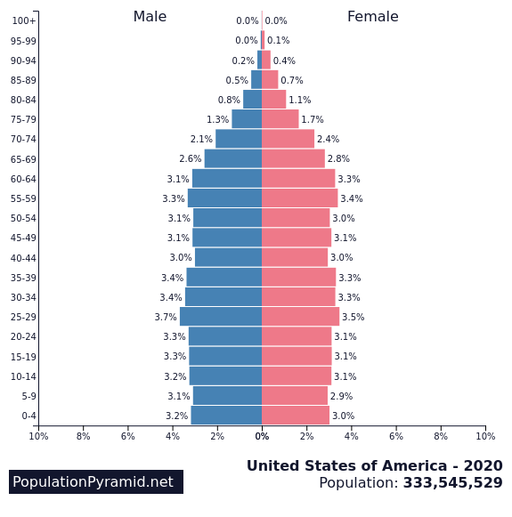
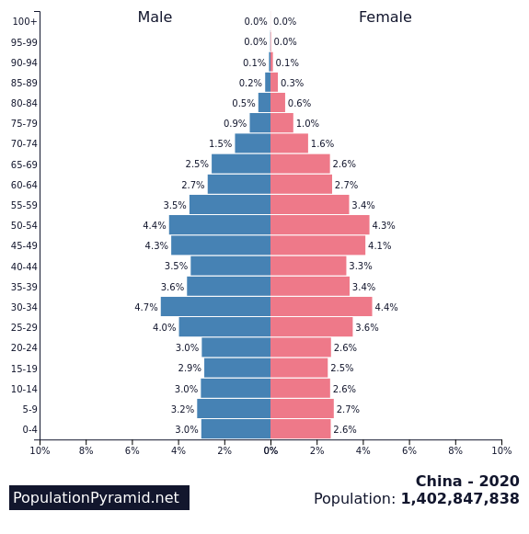
Demographic demons 2020
Notes:
The 2020s will be a difficult decade for both countries. In America we will be working through the demographic bomb of baby-boomer decrepitude. This problem will be much worse in China as the population bulges are more dramatic there. Not reflected in either graph are the growing divides between rich and poor in both countries. In China half the population lives in low-income rural areas with social service levels far below those living in the huge, coastal metropolises.

Slide 8
Gender inequality index (United Nations, 0.0 = equality)
Notes:
A composite measure reflecting inequality in achievement between women and men in three dimensions: reproductive health, empowerment and the labour market. Switzerland scores best (gender inequality is lowest) at 0.039, Papua New Guinea and Chad are worst at greater than 0.70. Things are improving in both countries and inequality declines if only marginally.l

Slide 9
Homicide rate (per 100,000)
Notes:
A measure of the level of violence in the countries: Homicide rates are very different in the two countries. The most recent increases in the U.S. are troubling.

Slide 10
Military Spending (billions, current US$)
Notes:
These are inflation adjusted numbers. Since the late 1990s we have seen a steady increase in Chinese defense spending, as the nation has invested more in defense articles and services aimed at domestic security, as well as deploying more military personnel abroad for such purposes as UN peacekeeping operations. The two nations spend more on their militaries than any other countries – in the US it amounts to 3.2% of GDP, in China 1.4%. Both countries are spending more this year than last.

Slide 11
Foreign aid distribution
2000-2014 (different scales)
Notes:
The above shows the top ten recipient countries of official development assistance (foreign aid) from China and the U.S. Among other observations, China’s aggregate foreign aid distribution by country (2000-2014) shows Venezuela as the top recipient. The composition of aid projects to Venezuela span agricultural, commercial/industrial and residential sectors, some part of long-term bilateral cooperation frameworks between the two states, others one-off aid packages. Venezuela’s socialist form of government may in part explain the level of aid it receives from China, as countries often send aid to countries with similar political/governance orientations (hence Russia being the second largest recipient of Chinese aid). Whether this is indicative of China “exporting” a form of authoritarian government via aid, or if it simply reflects attempts at access to the massive oil reserves of the country, these are questions researchers may further explore by directly accessing the China outward ODA data from William & Mary’s AidData lab (https://www.aiddata.org), a rich source of international aid data worldwide.
Israel is the largest recipient of U.S. foreign aid, while China is one of the comparatively smallest recipients, which does not register among the top ten recipients. While USAID data on U.S. foreign aid distribution by country is available back to year 1946, we use 1980 as the starting year since for comparability purposes—1980 is the starting year for U.S. foreign aid to China covered in our U.S.-to-China aid chart presented here. China’s relatively low relative rank among recipients of U.S. aid does not suggest that China is unimportant to U.S. foreign policy goals, but rather reflects the vast collective agenda of U.S. foreign security, economic and development policy goals. Source: USAID (see: https://explorer.usaid.gov/query)

Slide 12
Internet users (%)
Notes:
As personal income increases in China, so too does access to such modern amenities as the Internet. Growth in the US has slowed over the past decade.

Slide 13
Mobile Phones (%)
Notes:
Mobile phone penetration is over 100% in both countries. We included the numbers for Hong Kong, the highest penetration rate in the world – the average person owns two!

Slide 14
Energy use (kg of oil equivalent per capita)
Notes:
Albeit slowly, energy use is converging. Of course, America’s appetite for energy is the highest in the world. But at least in recent years things have begun to improve in the States. We note that energy imports as a percentage of total use peaked in 2005 at 30%. In 2011 it declined to 19% in the US. China was an energy exporter until 1998 while in it now imports more than 10% of its energy used.

Slide 15
CO2 emissions (metric ton per capita)
Notes:
The associated pattern in CO2 emissions suggests little real progress in alternative energy solutions in either of the two biggest polluters in the world. The CO2 pollution problem has declined by 6% during 2010-2014 in the U.S. while it has increased 23% in the same time period in China.

Slide 16
Greenhouse gas reductions versus increases in 10 cities: United States (2005-2013)
Reduced
Increased
Notes:
The greenhouse gas emissions reduction versus increases over 2005-2013 time in 10 large U.S. cities in is shown above, with a comparison to the China in the next slide. Cities are the largest source of emissions in any given country, thus both analysis and policy action on climate change require an emphasis on the local-level in addition to the national level.
The above U.S. map (and the corresponding China map on the next slide) provide an interesting first look at which locales have map progress in reducing emissions during this time period, and those falling behind. As more updated inventory data becomes available over time, the geography of urban emissions will change, as cities previously increasing emissions yet implementing climate action reach an inflection point and begin to reduce.
An important note is that this obscures the larger trend: The U.S. has made far more progress on urban emissions reduction than has China, which in large part explains how U.S. national emissions are decreasing while China’s have only increased (during the observed time period).
Node size for reductions and increases in both maps are displayed proportional to amount reduced/increases. Sources of data for U.S. city-level greenhouse gases were city government website-reported inventories, Carbon Disclosure Project (CDP), carbonn Climate Registry, and C40 Cities Climate Leadership Group’s (C40) Greenhouse Gas for Cities Dashboard, spanning the observed years.

Slide 17
Changes in greenhouse gas emissions: 10 large Chinese cities (2005-2012)
Reduced
Increased
Notes:
Data for China is derived from the 2005 and 2012 greenhouse gas emissions data from Cai et al. (2019), and Liu and Cai (2018), respectively for the same 281 prefectural- and provincial-level cities in China, and both using bottom-up China High-Resolution Emission Gridded Database (CHRED) measurements. These studies are accessible below.
-Cai et al. (2019): https://www.sciencedirect.com/science/article/pii/S0306261918315733.
-Liu and Cai (2018): https://www.belfercenter.org/sites/default/files/files/publication/Emissions%202018.pdf

Slide 18
Corruption Perception Index (higher scores mean bribery is less common)
Notes:
Here higher numbers reflect less corruption, specifically of the bribery sort. Marginal improvements can be seen in China during the last five years. Again, we have provided the Hong Kong numbers to suggest how things might be improved in the two larger entities. New Zealand was ranked #1 with a score of 89, Somalia was ranked #180 (last) with a score of 10, while the U.S. was ranked #16, Hong Kong #13, and China #77 for the 2017 Index.

Slide 19
Piracy rates for computer software (% unlicensed use)
Notes:
Piracy rates continue to declining in all three places. We do note that despite the lower piracy rate for the U.S., more money is lost to software piracy in the U.S. than in any other country. The 2016 losses in the U.S. were $8.6 billion, China $6.8 billion, and Hong Kong $277 million.

Slide 20
Interaction
The second group of slides presents measures of the mostly increasing interaction of the two countries. In many respects we see a strengthening of the bi-lateral relationship, but there is also disappointment in the latest data.

Slide 21
Trade in goods ($ billion)
Notes:
The growth of Chinese exports to the U.S. remains unabated in 2018 despite increased tariffs in the U.S. However, U.S. exports to China declined last year. We note that these merchandise trade statistics underestimate the overall trade relationship as services exports are ignored. For the U.S. exports of services add approximately another 40% to total exports to China.

Slide 22
Total U.S.-China trade in goods and U.S. trade deficit in goods ($ billion)
Notes:
With the exception of 2009 total trade between the two countries has continued to burgeon until 2016. The trade imbalance declined marginally in 2016 as it did during the 2009 debacle. Indeed, the U.S. trade deficit with China is still the largest of that with all countries. China has invested its trade surplus into U.S. treasuries and most recently into U.S. FDI as will be seen in successive slides. Also, the recent loosening of currency exchange rate restrictions in China will theoretically help as well. Finally, it is important to consider that the U.S. trade deficit shown above is overstated in two respects. (1) The U.S. has a trade surplus with China in services as with the rest of the world. (2) Many of the products sent from China to the U.S. are simply assembled in China. For example, the value of iPhone 3G shipped from China to the U.S. contains only 3.6% of components and labor from China. Overall, a record U.S. trade deficit with China represents a growing policy problem for the world for 2019.

Slide 23
Historical currency exchange rate (yuan per one dollar)
Notes:
In 1994, the yuan was pegged to the U.S. dollar at a value of 8.28, for the purpose of taming domestic instability and to benefit PRC exports. In July 2005, due to pressure from China’s major trading partners, China moved away from the fixed dollar peg, allowing the yuan to gradually appreciate. China sought to internationalize the yuan, which requires a stronger currency. One goal to this end was to get the yuan added to the International Monetary Fund’s Special Drawing Rights basket of reserve currencies—which in 2015 the yuan officially was. However, between the end of 2013 and start of 2014, the dynamics of global currency markets caused the yuan to once again depreciate and continue into 2018. Noteworthy is that this depreciation notwithstanding, it is nevertheless the Chinese government’s goal to strengthen the yuan, not weaken it.

Slide 24
Exchange of direct investment
Source: Rhodium Group
Notes:
Rhodium Group tracks bilateral foreign direct investment between the U.S. and China going back to 1990, as shown above. While 2016 was a record year for Chinese direct investment into the U.S., 2017 brought a sharp drop. Rhodium Group attributes the drop primarily to Beijing’s regulatory crackdown on outbound capital flows, and secondarily to stricter screening on the U.S. side. Specifically, China has been struggling to reduce its debt, and with many China-to-U.S. investments having been using debt, this had been consuming a large amount of China’s foreign exchange reserves. These conditions can put a general drag on the Chinese economy, and can threaten China’s efforts to appreciate its currency. Hence, Beijing cracked down on a series of such outbound investments, many of which comprise a large portion of U.S.-to-China direct investments, such as real estate. The secondary cause of the drop in investment between the two countries stemmed from the Committee on Foreign Investment in the United States (CFIUS), which screens foreign acquisitions (non-U.S. entities investing in and acquiring enterprises on U.S. soil) for national security risks. CFIUS added more and broader criteria to its screening process for Chinese acquisitions, slowing down and stopping many investments which otherwise may have occurred. Further contributing to the stemmed investment was the slowness of the Trump administration in staffing a range of pertinent leadership positions, causing delays in investment processing.
The Trump administration’s National Security Strategy, issued in late 2017, redefines China as a strategic rival rather than engagement partner, departing from the approach of previous administrations. Rhodium Group notes: “This change to a confrontational economic-security policy will almost surely sour the US-China investment climate, with negative implications for future flows.” These data do not include the substantial Chinese investment in residential real estate in the U.S. which has also declined in 2017-2018.
A full report on the investment drop can be found here: https://www.rhg.com/research/chinese-fdi-in-the-us-in-2017-a-double-policy-punch/
The graphs included in this slide can also be accessed in interactive (and geographic) form at the following site: https://rhodiumgroup.gistapp.com/us-china-foreign-direct-investments

Slide 25
Chinese holdings of U.S. treasuries ($ billion)
Notes:
The growth in Chinese holdings of U.S. treasures has in recent years slowed from its torrid pace. While some argue that this link between the two countries is dangerously volatile, the girth of this Chinese investment in the U.S. renders it much less so.

Slide 26
Travel between countries (thousands of passengers)
Notes:
Growth in travel to China by Americans has returned in the last three years. Meanwhile, Chinese travel to the U.S. has burgeoned since 2009. This adds up to new levels of interaction between citizens of the two trading partners.

Slide 27
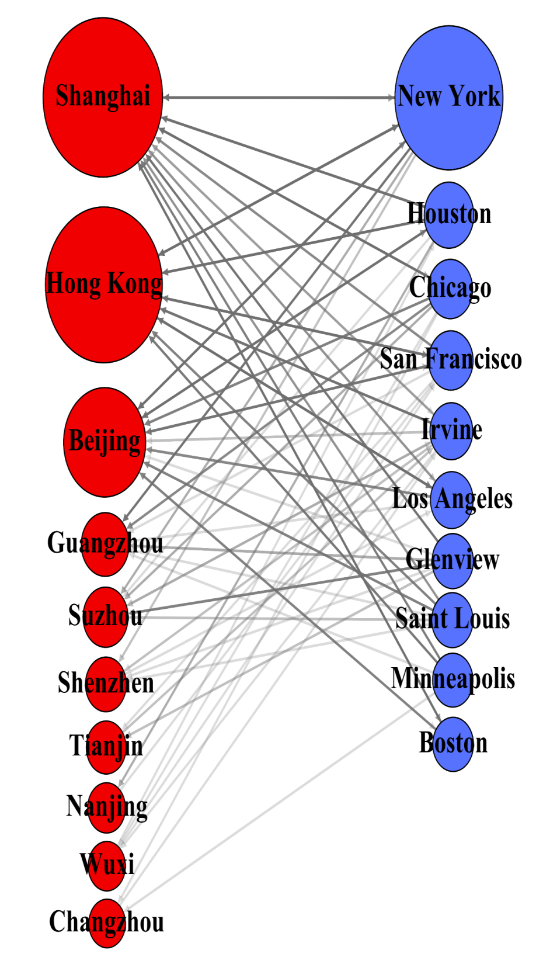
Top 10 gateway cities for bi-lateral commerce
(trans-Pacific links between corporate HQs and their subsidiaries and branches)
Source: Benjamin Leffel, Dept. of Sociology, UC Irvine
Notes:
We gathered data for 2018 on all multinational corporations earning $10 million and up located in both the U.S. and China, including city-level location of both headquarters and branch location. We then aggregated all corporate headquarter-branch ties to the city-level in both countries, and filtered the sample down to only city-corporate ties between the U.S. and China, resulting in over 6,000 U.S.-China city-level corporate ties. Displayed are the top 10 cities in each country, with red and blue nodes representing U.S. and Chinese cities, respectively, and with gray lines representing corporate headquarter-branch ties. Node size is displayed proportional to the aggregate number of both headquarter and branch ties in the sample, arranging the top cities from each country separately as vertical columns in descending order of connectivity. This displays a unique and telling economic geography on a granular urban level. Data was sourced from the Mergent Intellect (Dun & Bradstreet) database.

Slide 28
U.S. patents granted to invention teams that include both American and Chinese citizens
Notes:
Perhaps the most troubling datum in the Barometer is the first ever year-to-year decline in the collaboration of American and Chinese inventors. During the last decade the growth of collaboration in invention has been quite impressive as illustrated by this graph. While the overall numbers remain small – the U.S. patent offices grants approximately 250,000 patents each year – this does demonstrate that collaboration in R&D is growing fast, despite the decline in 2018. We have included the numbers of Chinese/California (only) invention teams in orange, demonstrating the close relationship between China and the most inventive state.

Slide 29
WTO complaints filed
Notes:
Some might say that the increase in trade disputes between the two countries is a bad thing. To the contrary, we see the increasing use of the WTO to mediate such disputes a sign of a healthy trade relationship. Third party mediation is the best prophylactic against the damaging trade wars of the past.

Slide 30
Animation of U.S.-China sister city formation, 1979-2009
Play
Notes:
The formation of U.S.-China sister city relationships shows coastal-to-inland pattern in Chinese cities over time, and a more random geographic distribution of American counterpart cities. China’s reform and opening up beginning in the late 1970s involved the central government favoring coastal provinces for outward international exchange, by establishing Special Economic Zones and other preferential economic zoning designations, often involving tax breaks to incentivize foreign investment, the establishment of foreign branches, and other forms of commercial engagement. While inland provinces (and cities) would come to develop their own international engagement over time, the coastal region was the first to internationalize, hence the coastal-to-inland pattern seen in Chinese cities for the establishment of sister city relationships with the U.S.
In general, China’s reform and opening up meant not only a new era of diplomatic relations between the national governments of China and the U.S., but also between its cities, thus Saint Louis and Nanjing were quick to establish the first relationship in 1979, followed by San Francisco and in Shanghai in 1980, and so forth. Each new frame of the animation shows a new year, starting with 1979 and ending in 2009, with 153 sister cities ties in total. While U.S.-China sister city relationships have continued to be formed after 2009, this was the range for which the most reliable longitudinal data could be gathered at present.

Slide 31
Educational exchange students
Notes:
Educational exchange between the two countries remains dominated by Chinese students coming to the U.S. Meanwhile, American students travel to China has stabilized at a discouraging low level. Most analysts expect marginal declines in Chinese students in the U.S. the near future, but this sea change is not reflected in the most recent statistics available.

Slide 32
Chinese language training in higher education in U.S. (number of students)
Notes:
While the recent declines in American students’ Chinese language training is troubling. It remains now a smaller drop in the bucket as it is less than 1% of all American college students. Alternatively, all Chinese students take English as part of their tertiary education. Chinese is the 6th most popular foreign language for American students, far behind Spanish, French, German, Japanese and Italian in that order.

Slide 33
Public opinion (Pew Research Center 2019)
Americans’ ratings of China,
% approving
Chinese ratings of America,
% approving
Notes:
The Pew Research Center annually provides two-way public opinion surveys among several countries. It is difficult to see a pattern in the Chinese views of the U.S. – the favorable ratings vary around 45% during the last decade. Alternatively, public opinion about China experienced a dramatic and persistent drop off after 2011 in the U.S. For a more fine-grained view of two-way public opinions (on the threats of climate change and military engagement, potential conflicts over trade and Taiwan, and mutual trust by the Committee of 100 Opinion Survey) contact Ben Leffel at bleffel@uci.edu. Finally, we note an a marked improvement of Americans’ views of China as measured during 2017.

